Slide 1

What Has GOD Given Me?
Part 2
“Come and hear, all you who fear God, And I will declare what He has done for my soul” (Ps. 66:16).

Slide 2
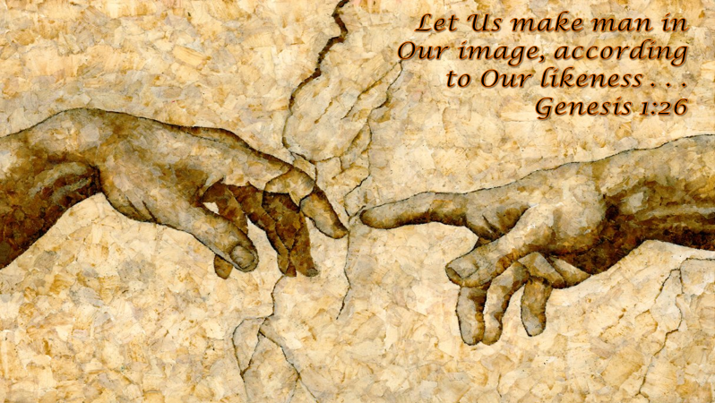
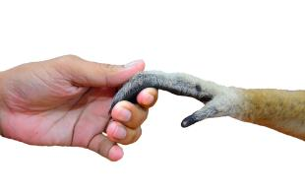
What Has God Given Me?
(1)
God has given me HIS IMAGE Gen. 1:26
Not a glorified animal!
James 3:9, “With it we bless our God and Father, and with it we curse men, who have been made in the similitude of God.”

Slide 3

What Has God Given Me?
(2)
God has given me HIS SON
Jn. 3:16
Galatians 2:20, “I have been crucified with Christ; it is no longer I who live, but Christ lives in me; and the life which I now live in the flesh I live by faith in the Son of God, who loved me and gave Himself for me.”

Slide 4


What Has God Given Me?
Philippians 1:20, “According to my earnest expectation and hope that in nothing I shall be ashamed, but with all boldness, as always, so now also Christ will be magnified in my body, whether by life or by death.”

Slide 5
What Has God Given Me?
What effect would magnifying Christ have on my decision-making?
magnified
What kind of clothing I wear?
The places I frequent?
The activities I participate in?
What I view?
What I read?

Slide 6

What Has God Given Me?
(3)
God has given me HIS MIND
(1 Cor. 2:9-16)
1 Cor. 2:12, “Now we have received, not the spirit of the world, but the Spirit who is from God, that we might know the things that have been freely given to us by God.”

Slide 7
What Has God Given Me?
(3)
God has given me HIS MIND
(1 Cor. 2:9-16)
1 Cor. 2:13, “These things we also speak, not in words which man’s wisdom teaches but which the Holy Spirit teaches, comparing spiritual things with spiritual.”

Slide 8
What Has God Given Me?
1 Cor. 2:14-16, “But the natural man does not receive the things of the Spirit of God, for they are foolishness to him; nor can he know them, because they are spiritually discerned.
¹⁵ But he who is spiritual judges all things, yet he himself is rightly judged by no one. ¹⁶ For "who has known the mind of the LORD that he may instruct Him?" But we have the mind of Christ.
Ephesians 3:1-5; 5:17; 1 Corinthians 1:21

Slide 9
The Argument:
MAJOR PREMISE: no one can know the mind of the Lord (2:9, 11)
MINOR PREMISE: God has revealed His mind to us (2:10, 12, 13)
CONCLUSION: no one can rightly judge us without seeking
to instruct the Lord (2:14-16)

Slide 10
What Has God Given Me?
1 Cor. 2:14-16, “But the natural man does not receive the things of the Spirit of God, for they are foolishness to him; nor can he know them, because they are spiritually discerned.
¹⁵ But he who is spiritual judges all things, yet he himself is rightly judged by no one. ¹⁶ For "who has known the mind of the LORD that he may instruct Him?" But we have the mind of Christ.

Slide 11
What Is Rejected?
“I know that is what it says, but that is not what it means.”
“That is just your interpretation.”
?
“That cannot be true because God wants me to be happy.”
THE MIND OF CHRIST

Slide 12
¹⁶ But to the wicked God says: "What right have you to declare My statutes, Or take My covenant in your mouth,
¹⁷ Seeing you hate instruction And cast My words behind you?
¹⁸ When you saw a thief, you consented with him, And have been a partaker with adulterers.
¹⁹ You give your mouth to evil, And your tongue frames deceit.
Psalm 50

